Slide 1
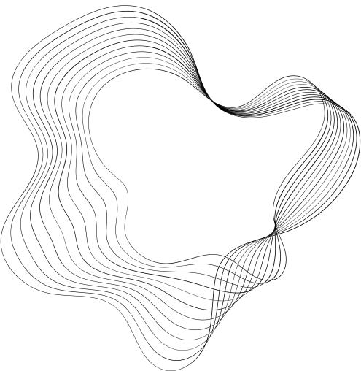

SYNTHETIC ECG SIGNAL GENERATION USING PROBABILISTIC DIFFUSION MODELS

Slide 2
GROUP MEMBERS-
SAGNIKA SEN - 22BEC10019
DEEPIKA GUPTA - 22BEC10030
ANAMIKA SHARMA - 22BEC10039
KUMARI AASTHA - 22BEC10029
HARI PRASAD REDDY - 22BEC10020
TEJASHVI RAJ - 22BEC10029

Slide 3
SYNTHETIC ECG SIGNAL
ECG Signal
Represents electrical activity of the heart
Helps in diagnosing cardiovascular diseases
Problem with real ECG data
Arrhythmia: Problem with the rate of heartbeat
Traditional treatment: Large real-world datasets used to train the models
Drawbacks:
Limited in size
Biased
Contain sensitive patient data

Slide 4
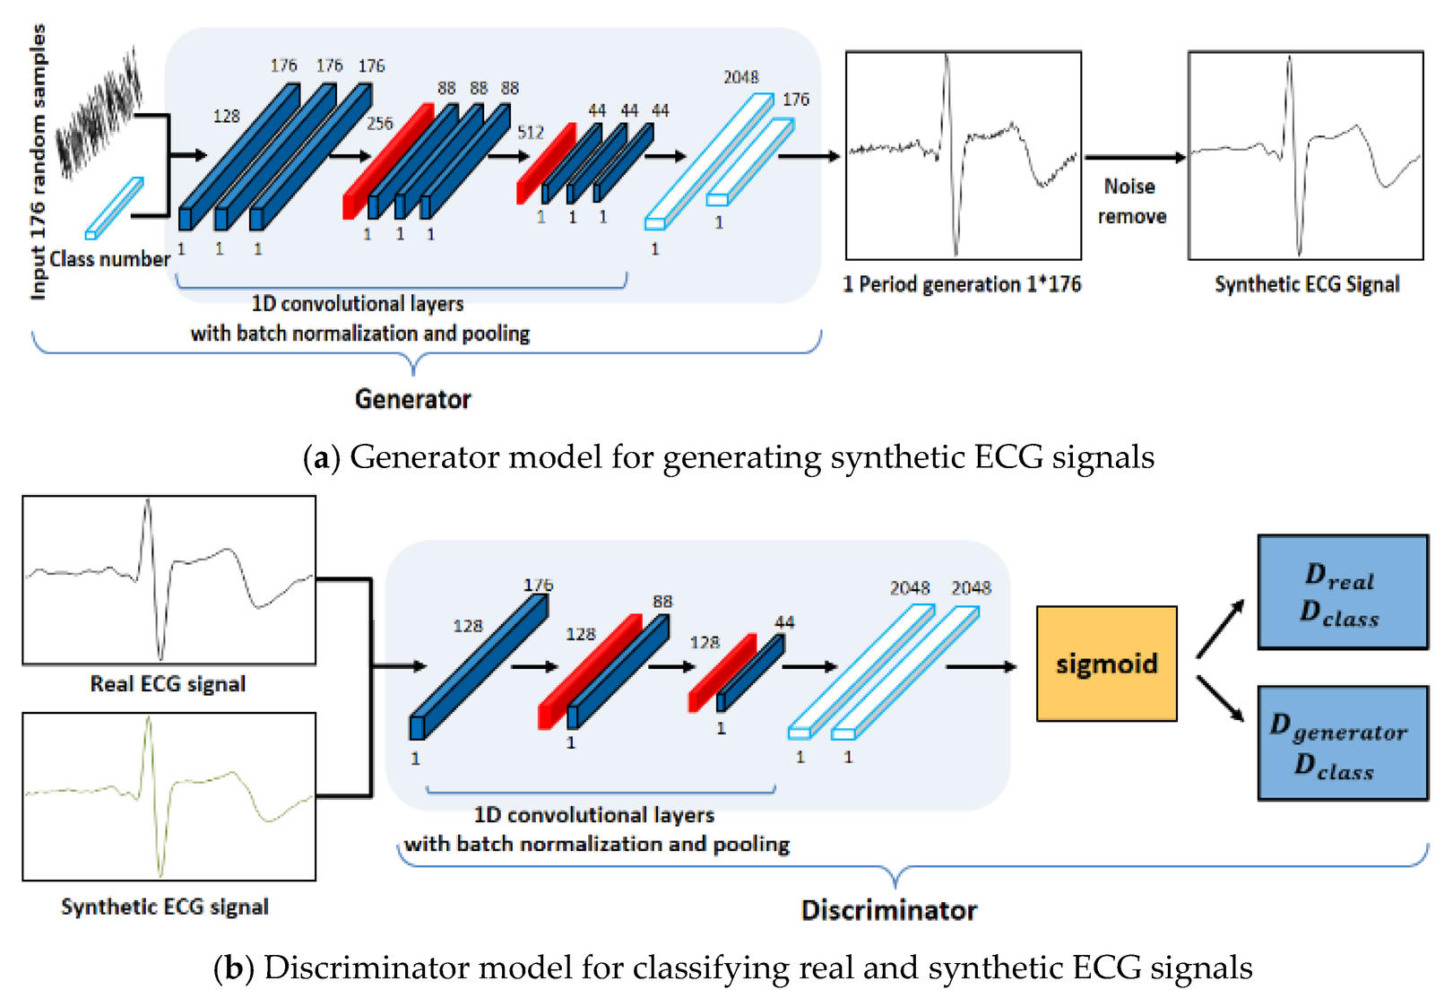
This is where Synthetic ECG Signal generation comes into the picture, providing
High Quality
Realistic data, that replaces the real data

Slide 5
PROBABILISTIC DIFFUSION MODELS
New class of generative models that does two processes;
Forward Process: Gradually add noise to real data
Reverse Diffusion: Learn how to reverse the process to generate new samples from pure noise
WHY USE DIFFUSION MODELS FOR ECG?
High-quality generation of realistic ECG signals
Augment training data to improve model generalization
Privacy preservation through synthetic data
Control over generation (e.g., produce signals with specific heart rates or rhythms)

Slide 6
DATASET
MIT-BIH Arrhythmia Database
contains 48 records from 47 patients
each record is taken for 30 minute duration from a single patient
Sampling Rate: 360 Hz

Slide 7
PREPROCESSING BEFORE GENERATION
Before training a diffusion model, ECG signals undergo:
Bandpass Filtering – Removes high-frequency noise and baseline drift
Normalization – Ensures consistent signal amplitude across samples

Slide 8
APPLICATIONS OF SYNTHETIC ECG DATA
Arrhythmia Detection & HRV Analysis
Training deep learning models to identify cardiac irregularities and analyze heart rate variability.
Edge Case Testing
Evaluating algorithm performance in rare or extreme physiological conditions.
Federated Learning
Supporting privacy-preserving research by enabling decentralized model training across devices.

Slide 9
FUTURE SCOPE
With further advances in diffusion models and signal conditioning, synthetic ECG can become a cornerstone for:
Scalable and safe AI development in healthcare
Simulated patient monitoring systems
Robust biomedical signal research

Slide 10
CONCLUSION
•The project prepares ECG data for deep learning through filtering, normalization,
•and noise handling. Using probabilistic diffusion models can enhance the quality
•and realism of synthetic ECG signal generation for model training and evaluation.
•Stay tuned for implementation updates and cleaned signal exports!

Slide 11
THANK YOU FOR LISTENING!

Slide 12
INTRODUCTION
ECG Signals in Healthcare:
ECG signals capture the electrical activity of the heart, essential for diagnosing cardiovascular issues like arrhythmias and heart attacks.
Challenges with Real ECG Data:
Limited Data: Real ECG datasets can be small and unrepresentative.
Bias in Data: Some datasets may not capture the full diversity of heart conditions.
Privacy Concerns:
Sharing real patient data for AI model training can breach privacy.
Need for Synthetic ECG Data:
Data Augmentation: Synthetic ECG signals provide more diverse data for training AI models, especially when real data is scarce.
Privacy Preservation:
Synthetic data eliminates privacy risks by not using patient-specific information.
.

Slide 13
SOLUTION: PROBABILISTIC DIFFUSION MODELS:
Probabilistic Diffusion Models are generative models that learn to add noise to data (forward process) and reverse it to recreate clean, realistic data (reverse process).
Application to ECG:
These models can generate realistic synthetic ECG signals by learning from real data, preserving the heart activity patterns.
Why Use Diffusion Models?:
They create high-quality, realistic ECG signals that are useful for training deep learning models.
They provide privacy-preserving synthetic data without revealing sensitive patient information.

Slide 14
PREPROCESSING BEFORE SIGNAL GENERATION
BANDPASS FILTERING:
Removes high-frequency noise and baseline wander.
Normalization:
Scales signals between a fixed range, ensuring uniformity across samples.
NaN & Artifact Handling:
Deals with missing data and artifacts, ensuring the dataset is clean and usable.
Segmentation:
Divides continuous ECG signals into fixed-length segments for easier model training.
Visualization:
Helps verify the quality of the data and the effectiveness of preprocessing steps.

Slide 15
ECG SIGNAL PREPROCESSING WORKFLOW
•1. LOAD ECG CSV DATA
•2. Apply bandpass filter
•3. Normalize the signal
•4. Handle NaNs and edge cases
•5. Visualize signal samples
•6. Batch process the full dataset
•7. Export cleaned signals

Slide 16
WHAT IS ECG SIGNAL GENERATION?
Electrocardiogram (ECG) signals represent the electrical activity of the heart and are vital in diagnosing cardiovascular conditions.
Traditionally, large real-world datasets like MIT-BIH Arrhythmia are used to train machine learning and deep learning models for tasks such as arrhythmia detection. However, these datasets can be:
- Limited in size
- Biased
- Contain sensitive patient data
This is where *synthetic ECG signal generation* comes in — providing high-quality, realistic signals to supplement or replace real data.

Slide 17
WHY USE DIFFUSION MODELS FOR ECG?
High-quality generation of realistic ECG signals
Augment training data to improve model generalization
Privacy preservation through synthetic data
Control over generation (e.g., produce signals with specific heart rates or rhythms)

Slide 18
PREPROCESSING BEFORE GENERATION
Before training a diffusion model, ECG signals undergo:
Bandpass Filtering – Removes high-frequency noise and baseline drift
Normalization – Ensures consistent signal amplitude across samples
NaN & Artifact Handling– Replaces missing or corrupted data
Segmentation – Extracts fixed-length samples for learning
Visualization – Helps verify signal quality and preprocessing steps

